Slide 1

Smart Delivery Box
IoT Project
Group Members
Usama Azhar
Ayesha Ali
Abdul Wahab

Slide 2
Table of Content
Smart Delivery Box
Conceptual Design
Features of the Project
Hardware Requirements
Software Flow
Results
Issues
Demonstration

Slide 3
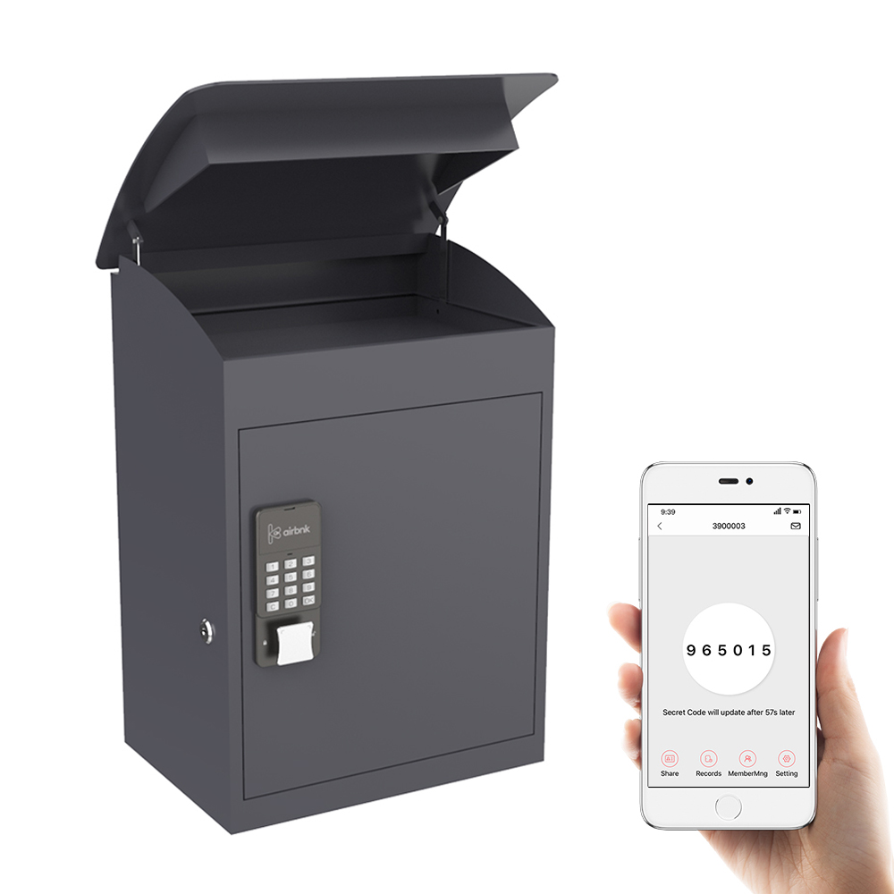
Smart Delivery box
Smart delivery box is a secure delivery box with
user feedback and control via NETPIE.
It provides secure and real time tracking
of the delivery.
Also, it can be monitored through app.

Slide 4
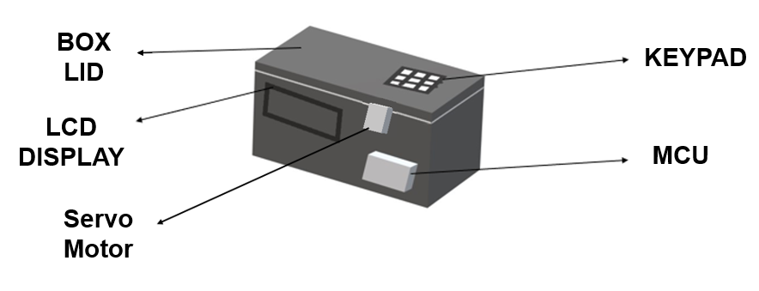
Conceptual design

Slide 5
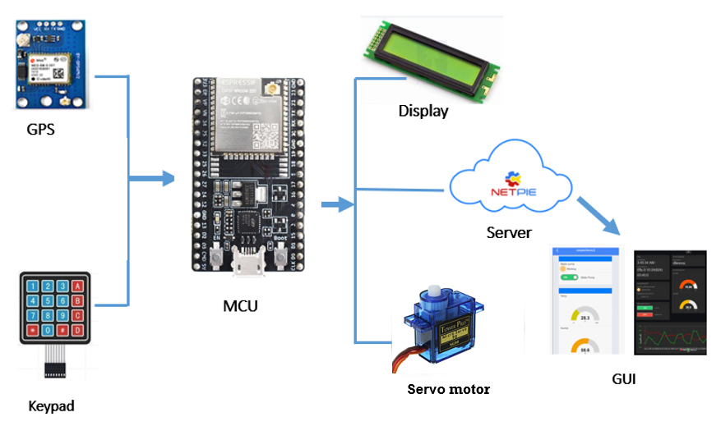
Conceptual design

Slide 6
Features (1/4)
The key features of the project includes
Real time location tracking through internet connectivity.
Password protected lock system implementation.
Mobile app for control.
Two modes: Master and user.

Slide 7
Features (2/4)
Real time location tracking
GPS module in delivery box to fetch location data.
Internet connectivity for location data transfer to NETPIE.
Data transfer to NETPIE after every 3 second.

Slide 8
Features (3/4)
Lock System
Electric lock operated using servo motor
Password implementation in software algorithm.
Password configuration from master app
Unlock from user input from keypad
Update NETPIE with lock status
Max number of wrong attempts detection and disable device.
App notifications and warnings.

Slide 9
Features (4/4)
Mobile app control
Password Configuration
Control of lock system
Providing real time tracking and status update
Display and Input
LCD display for user instruction.
Hex keypad for password and user input.

Slide 10
Hardware
The main hardware components used in project are
MCU: ESP32
Location (GPS): GPS Module NEO 6M
Connectivity: ESP32 built-in Wi-Fi
Display: 16*2 LCD
Keypad: Hex Keypad
Electric Lock: Servo Motor

Slide 11
Master’s mode
The Master’s Mode includes
Initial password configuration
Lock device for shipment
Real time tracking and status update
Device enable control
Password reset control

Slide 12
Software Flow (Master’s Side)
Start
Wi-Fi Connection
App Keypad
Configure Device Password
NETPIE App Connection
Lock
No
Device Enable
User Mode
Enable
Yes

Slide 13
User’s Mode
The User’s Mode includes
Unlock box through keypad
Location information on LCD of box
Permanently automatic box locked after max attempts exceed
Once box is opened previous password expired

Slide 14
Software Flow (user’s side)
Count > Max Attempt
Device Disabled
Start
LCD Display Messages
No
Yes
Password
Send Notification
Attempt Wi-Fi Connection
Keypad
Incorrect
Counter ++
Correct
No
Wi-Fi Connection
Turn Servo to Unlock
Yes
GPS Location
Status & Location Data to NETPIE
NETPIE
Connect to NETPIE
End

Slide 15
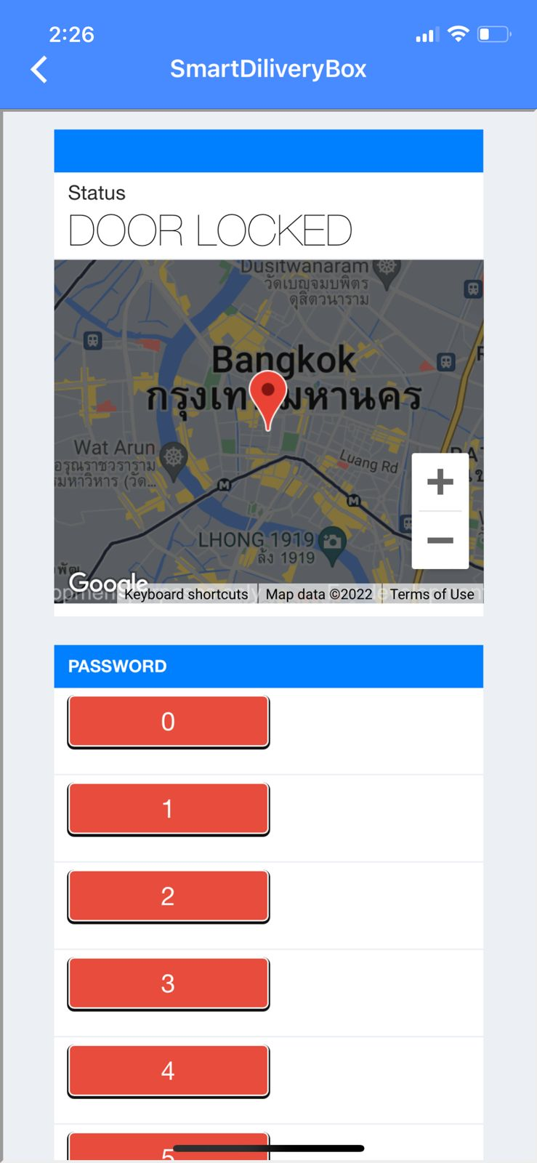
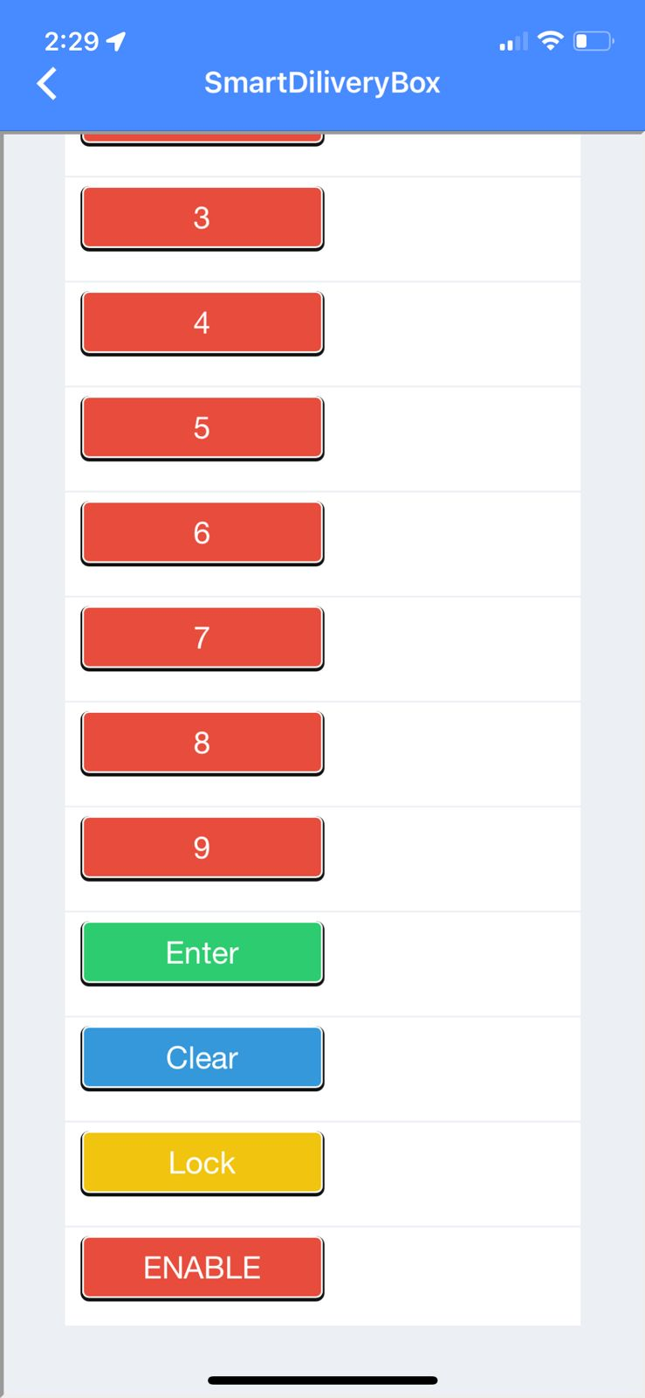
NETPIE APP Interface

Slide 16
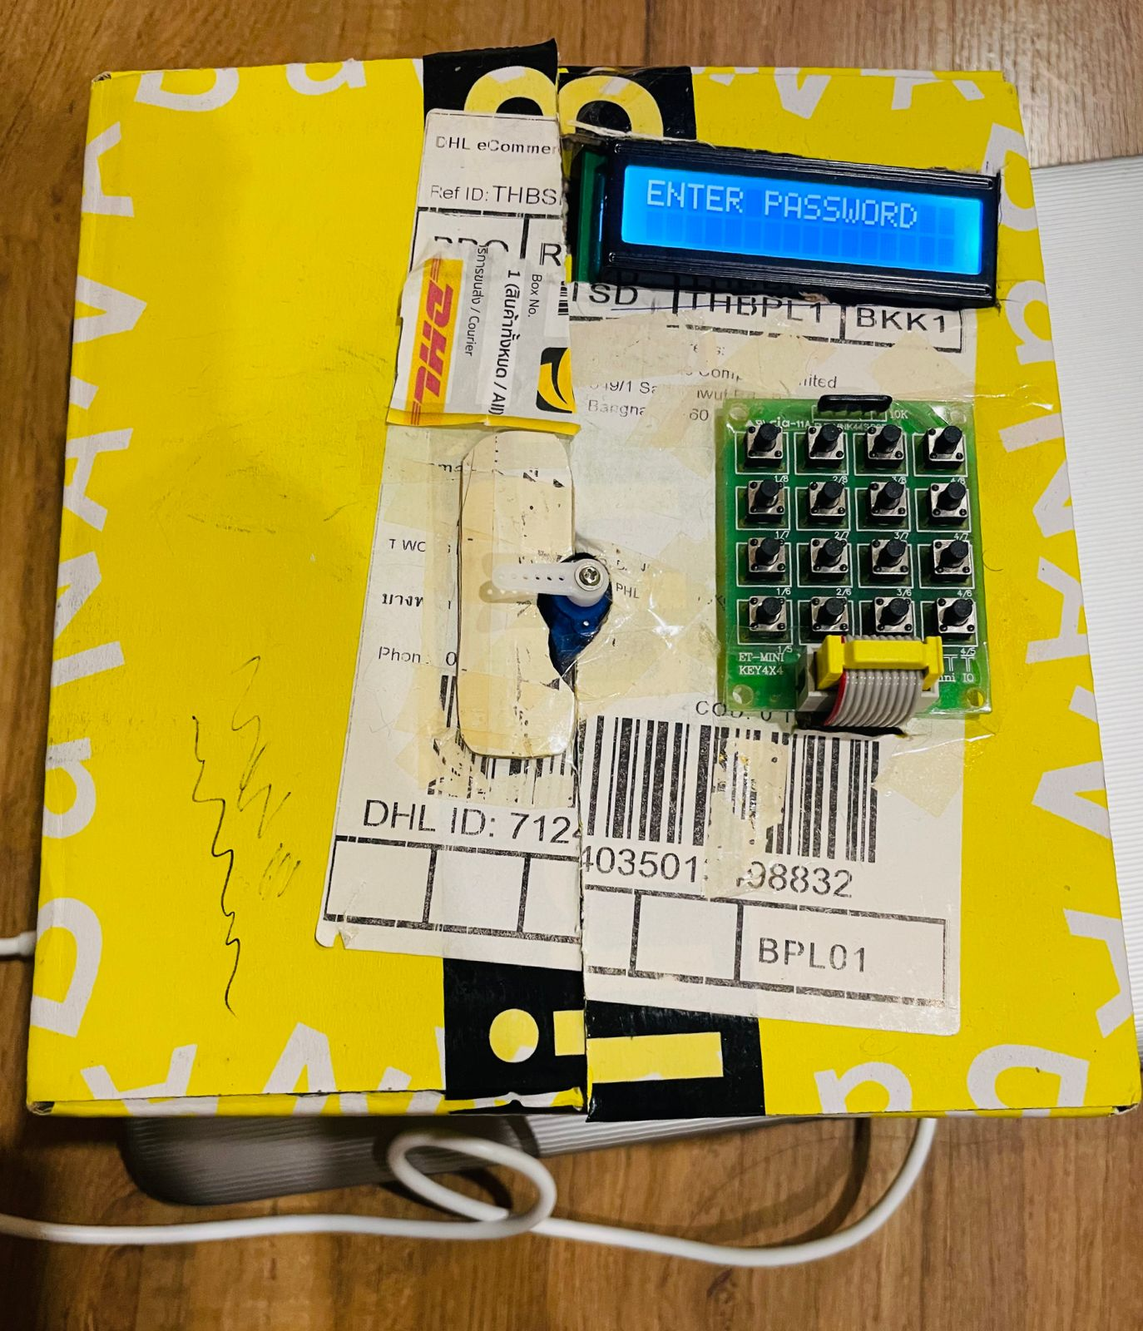
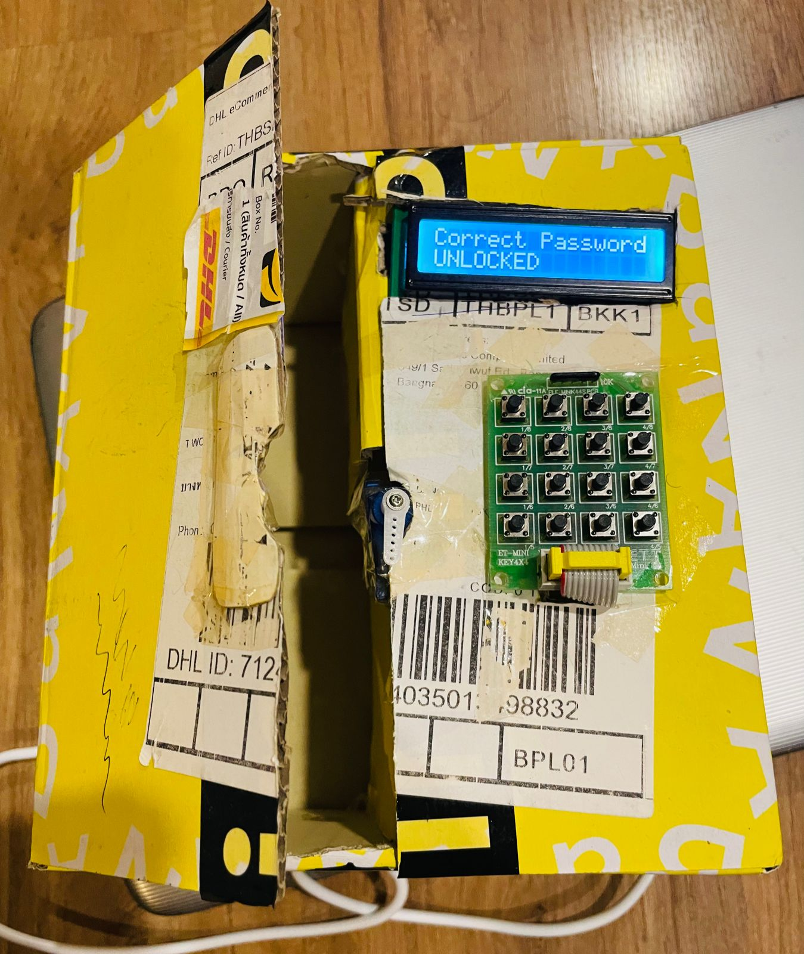
Our smart delivery box
LOCKED
UNLOCKED

Slide 17
GPS Issues
Problem:
GPS taking too long (30-45mins) outdoor for satellite connection, even much longer indoor. We have tried following things
Voltage regulator to provide stable voltage and a capacitor to reduce noise.
Tried GPS module at different indoor and outdoor locations
URANUS 622f and NEO 6m GPS modules were tried.
Possible Solution:
Use of enhanced Antenna with GPS module for better satellite connectivity.

Slide 18
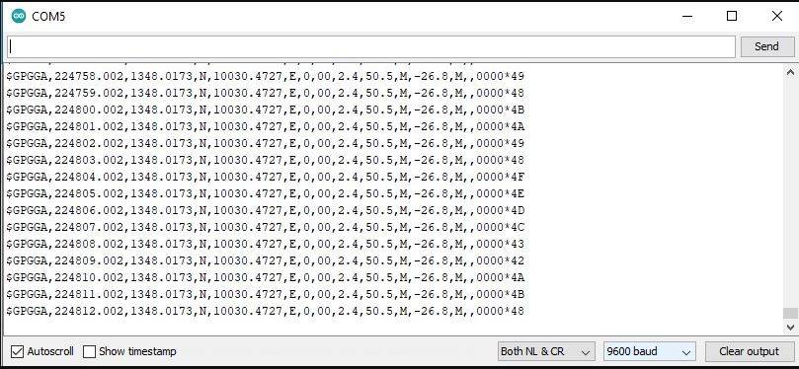
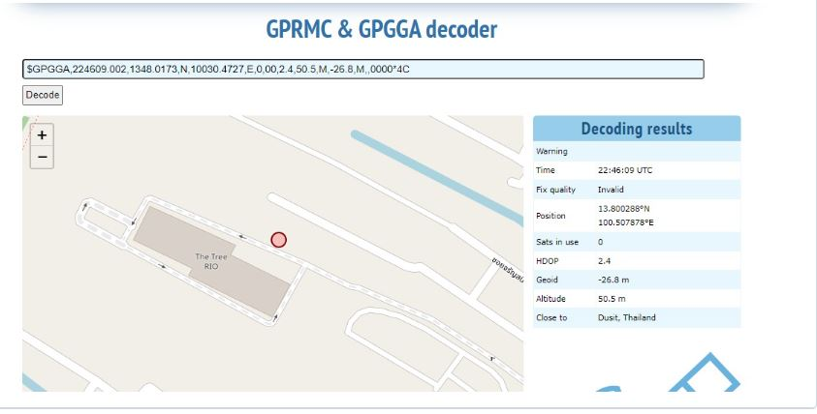
GPS Results
Accurate GPS results from outdoor connection after 30-40 mins

Slide 19
Any Questions ?

Slide 20
T h a n k Y O U !

